Slide 1
Lung cancer prediction
BY
Pragadeeshwaran S-241071
Tejeshwar M-241110
Ranjith M-241131
Vignesh K-241132

Slide 2
What is Lung Cancer?
Lung cancer is still remained the danger of society and reason for death of thousands of individuals in about the world.
Lung Cancer is deadly lung tumor considered by unmanageable cell extension in lung tissues.
This growth can spread to the surrounding tissue or other parts of the body apart from the lungs by the process of metastasis.
The majority of lung cancer cases (85%) are caused by prolonged tobacco smoking and approximately 10% to 15% of cases occur in people who have never smoked.
Some cases are caused by inherited factors and radon gas, secondhand smoke or other forms of air pollution.
Lung Cancer can be seen through chest radiographs and computed tomography(CT) scans.

Slide 3
Types of Lung Cancer
There are two main types of Lung Cancer:
Small Cell Lung Cancer(SCLC):
It often starts in the bronchi, then quickly grows and spread to other parts of the body, including the lymph nodes. This type of lung cancer represents fewer than 20 percent of lung cancers and is typically caused by tobacco smoking. Small cell lung cancer may be very aggressive and requires immediate treatment.
Non-small cell Lung Cancer(NSCLC):
Non-small cell lung cancer is the most common type of lung cancer. It accounts for nearly nine out of every10 cases, and usually grows at a slower rate than SCLC. Most often, it develops slowly and causes few or no symptoms until it has advanced.

Slide 4
Support Vector Machine(SVM)
The Support Vector Machine is a supervised machine learning algorithm that can be used for both classification and regression.
In any case, it is generally utilized in classification problem. The SVM algorithm aims to create the best line or decision boundary that can separate n-dimensional space in classes so that we can easily insert new data points into the correct range in the future.
This best decision range is called the hyper plane. SVM picks the vertex points/vectors that help to create hyper planes. These extreme cases are called as support vectors, and therefore the algorithm is called as support vector machine.

Slide 5
OBJECTIVES
The chi-square test allows you to solve the problem in feature selection by testing the relationship between two categorical outcomes features.
A chi-square test is used to check the independence of two features.
To identify the relevant attributes by using chi-square.
The chi-squared test is a difference between the observed value and expected value. The formula for chi-square is;
To propose Feature Selection using chi2 , reduce the complexity and high cost.

Slide 6
PROBLEM STATEMENT
The project aims to develop a predictive model that can accurately identify the presence of lung cancer in patients based on clinical and demographic data. Utilizing machine learning algorithms like KNN, SVM, and Logistic Regression, the model will analyze patterns and correlations within the data to predict outcomes. The goal is to provide a non-invasive, cost-effective, and efficient diagnostic tool that can assist healthcare professionals in early detection and treatment planning, ultimately improving patient prognosis and reducing mortality rates associated with lung cancer.

Slide 7
PROJECT OVERVIEW
The primary objective of this project is to develop a robust machine learning model capable of predicting the presence of lung cancer in patients. By leveraging three different algorithms—K-Nearest Neighbors (KNN), Support Vector Machine (SVM), and Logistic Regression—we aim to create an accurate and efficient diagnostic tool.

Slide 8
MODELING
Data Collection and Preprocessing:
Gather a comprehensive dataset containing relevant features such as patient demographics, clinical history, and diagnostic imaging results.
Clean and preprocess the data to ensure its quality and consistency.
Feature Selection and Engineering:
Identify the most informative features related to lung cancer prediction.
Create new features if necessary to enhance model performance.
Model Building:
Implement KNN, SVM, and Logistic Regression algorithms.
Train each model using the preprocessed data.
Fine-tune hyperparameters to optimize performance.
Model Evaluation:
Evaluate the models using appropriate metrics (e.g., accuracy, sensitivity, specificity).
Compare their performance to determine the best algorithm for lung cancer prediction.
Deployment and User Interface:
Develop a user-friendly software tool that integrates the best-performing model.
Provide healthcare professionals with an efficient and reliable tool for early lung cancer detection.

Slide 9
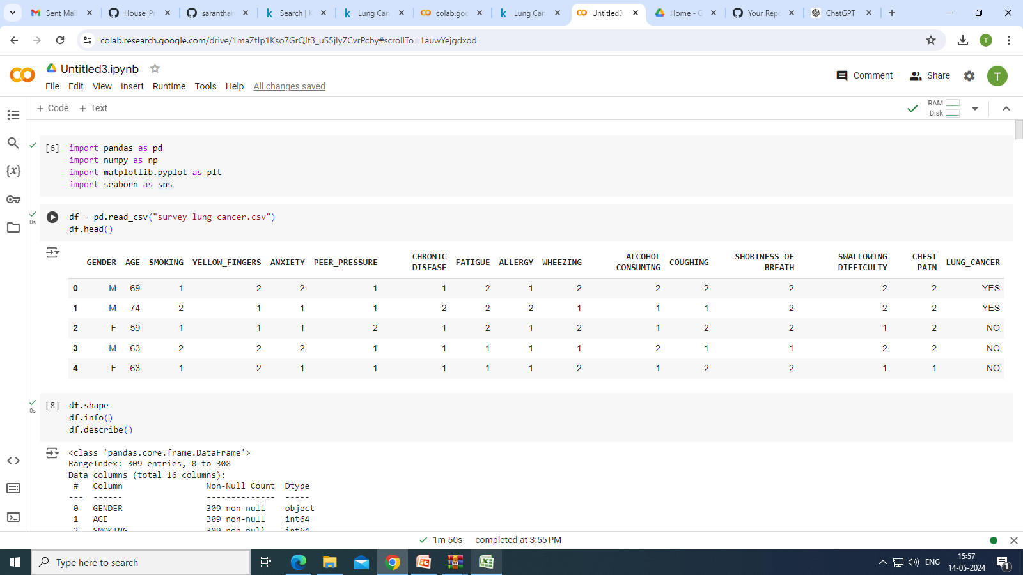
IMPLEMENTATION

Slide 10
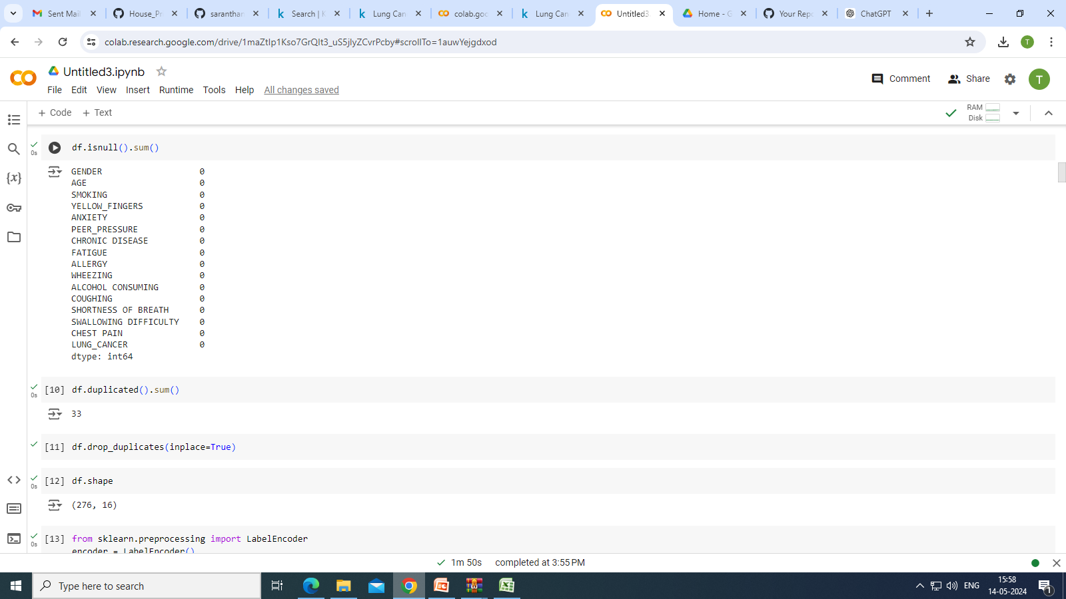

Slide 11
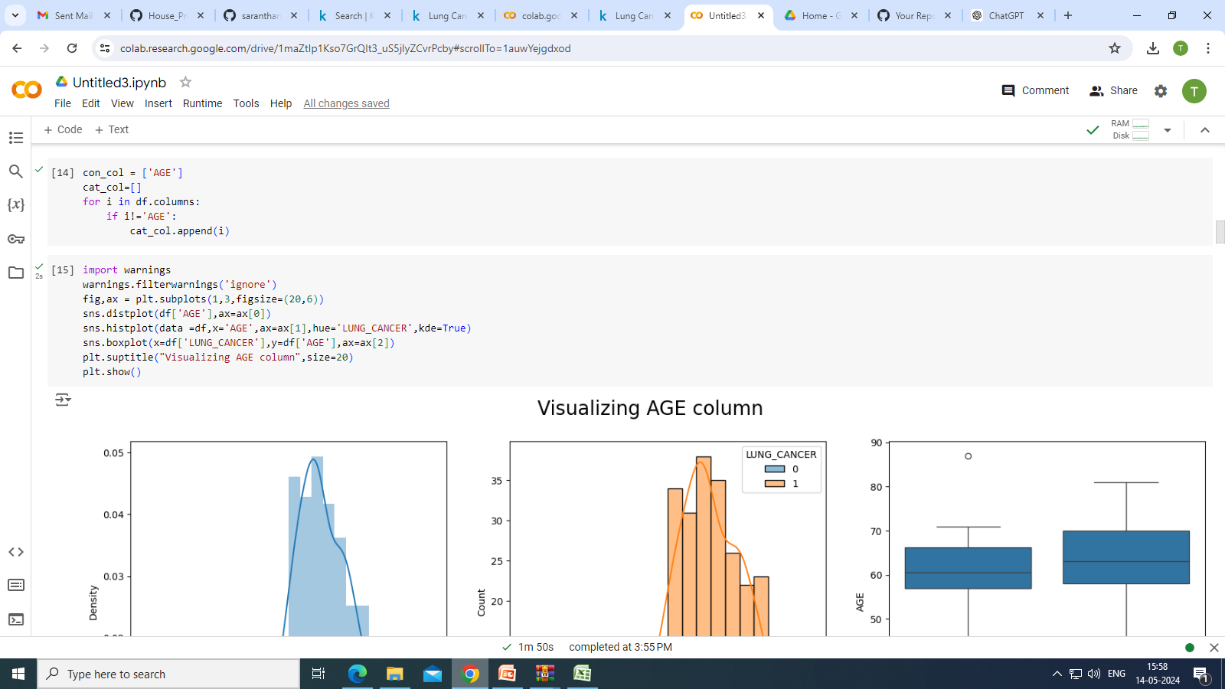

Slide 12
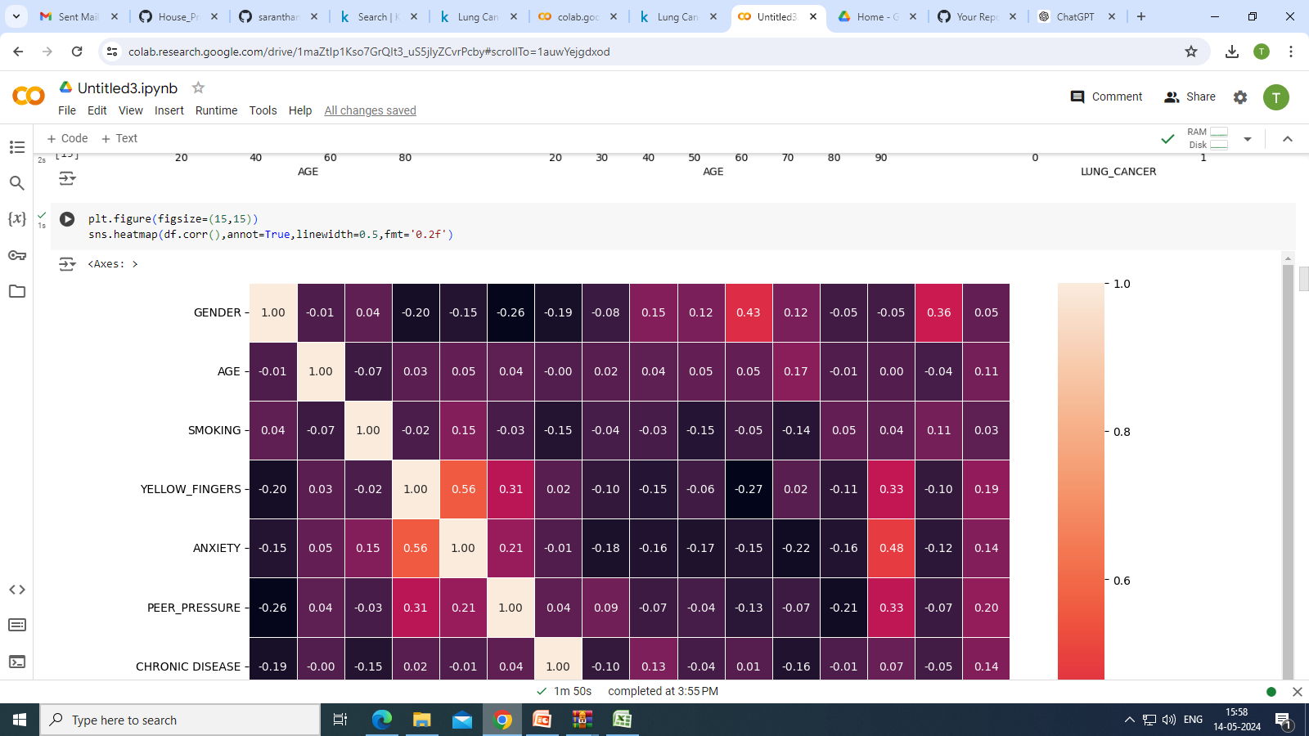

Slide 13
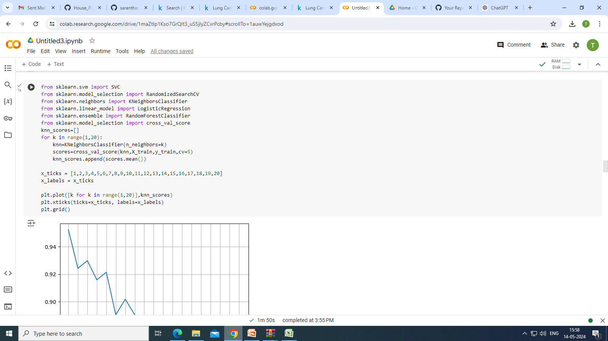
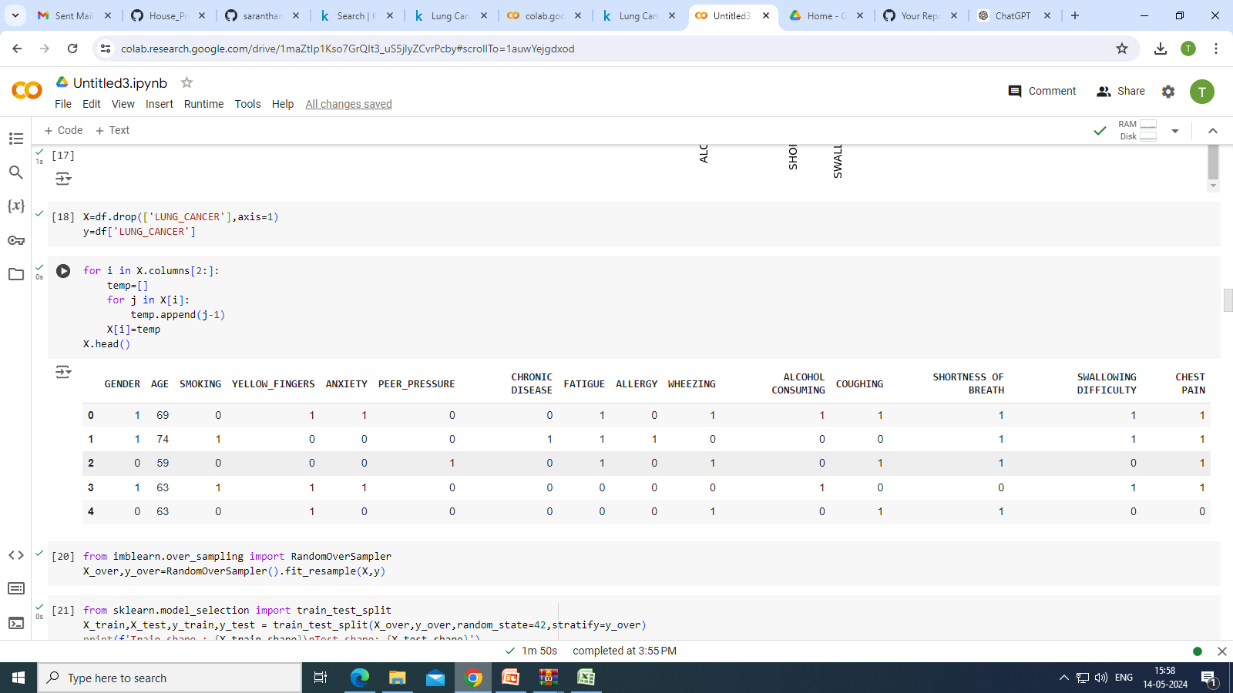

Slide 14
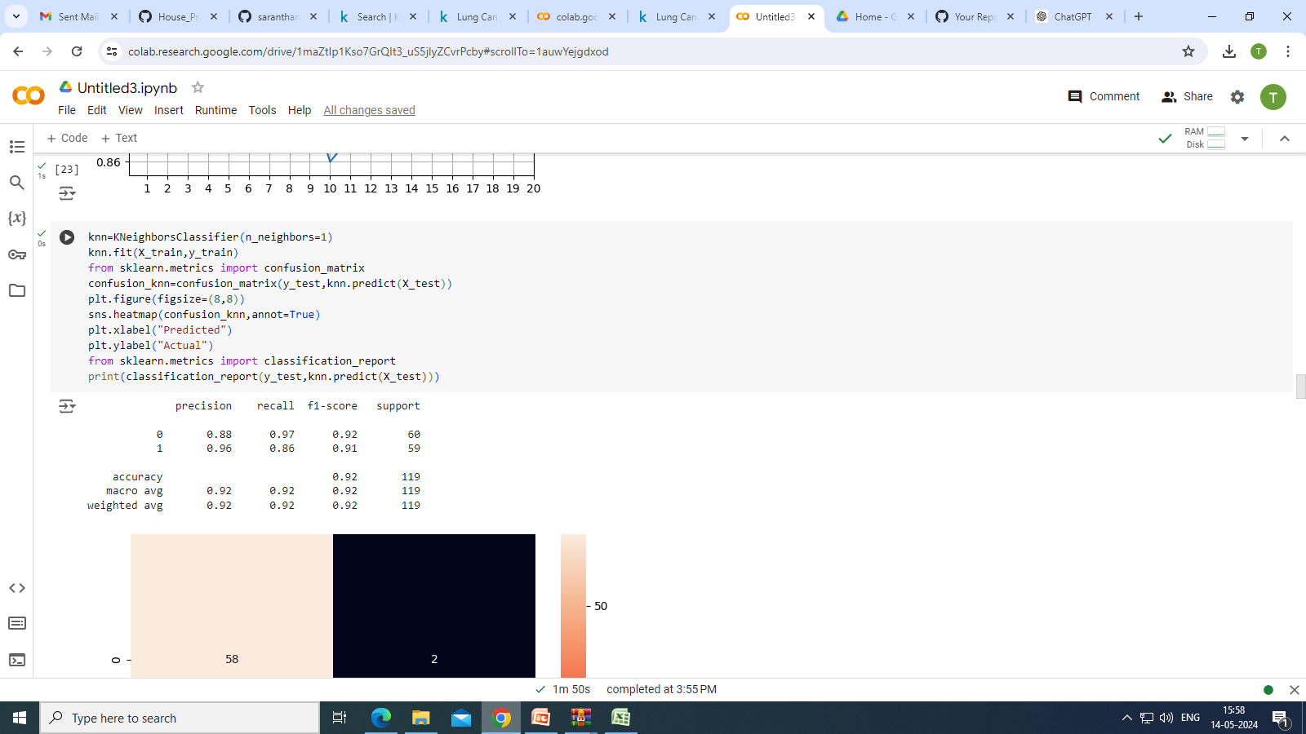

Slide 15
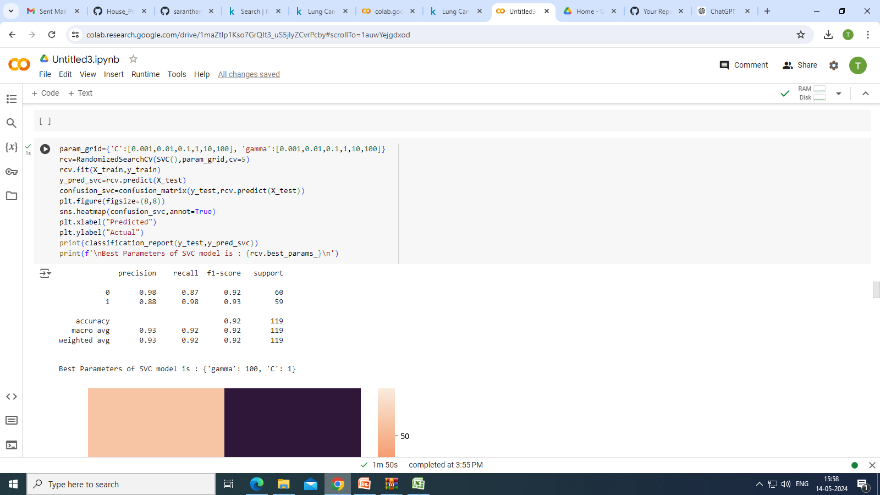

Slide 16
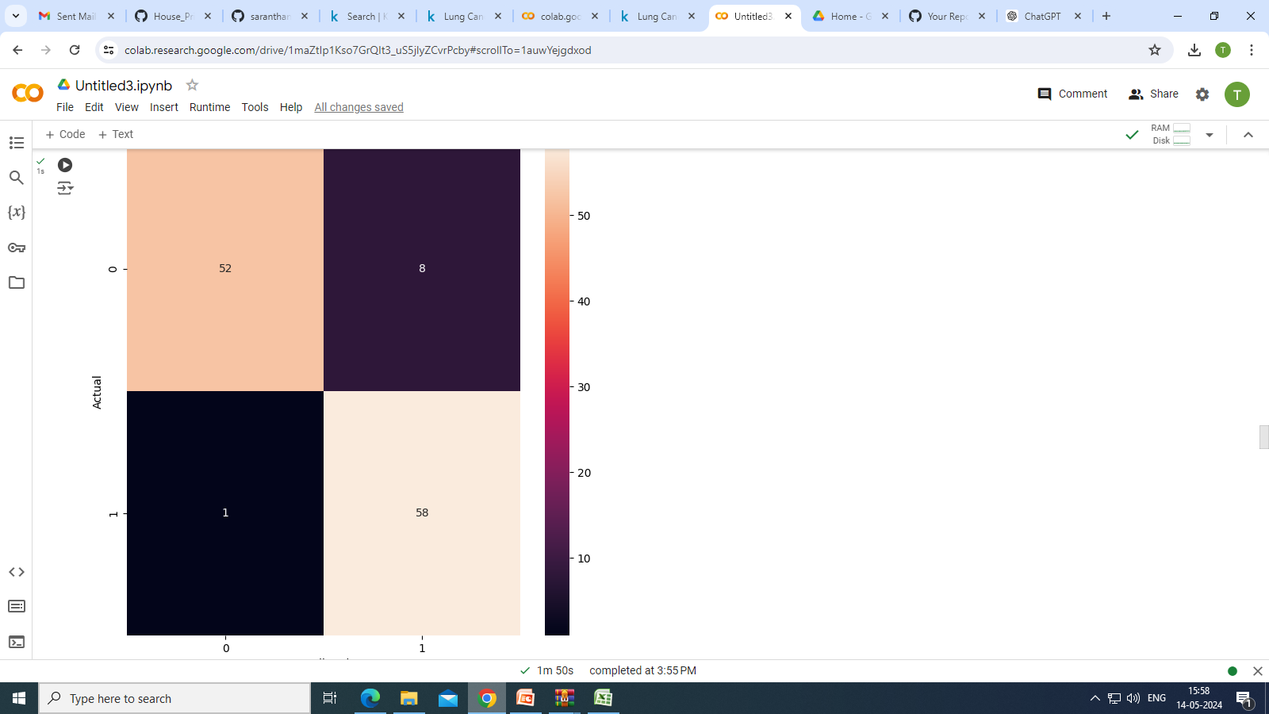

Slide 17
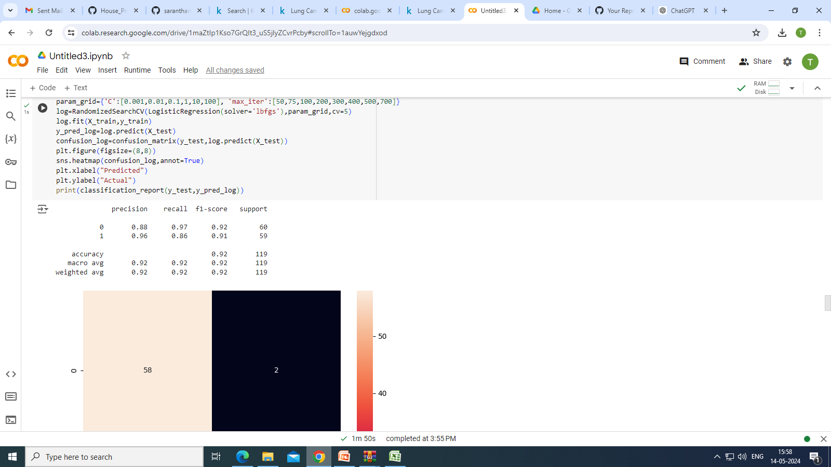

Slide 18
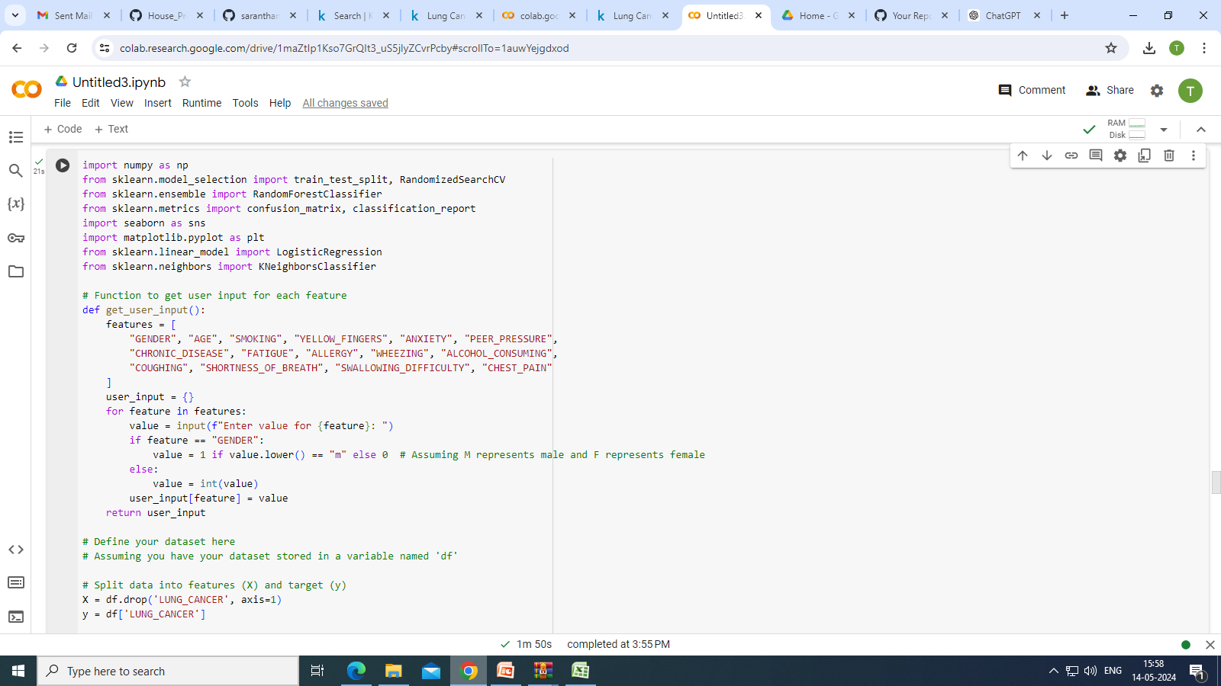

Slide 19
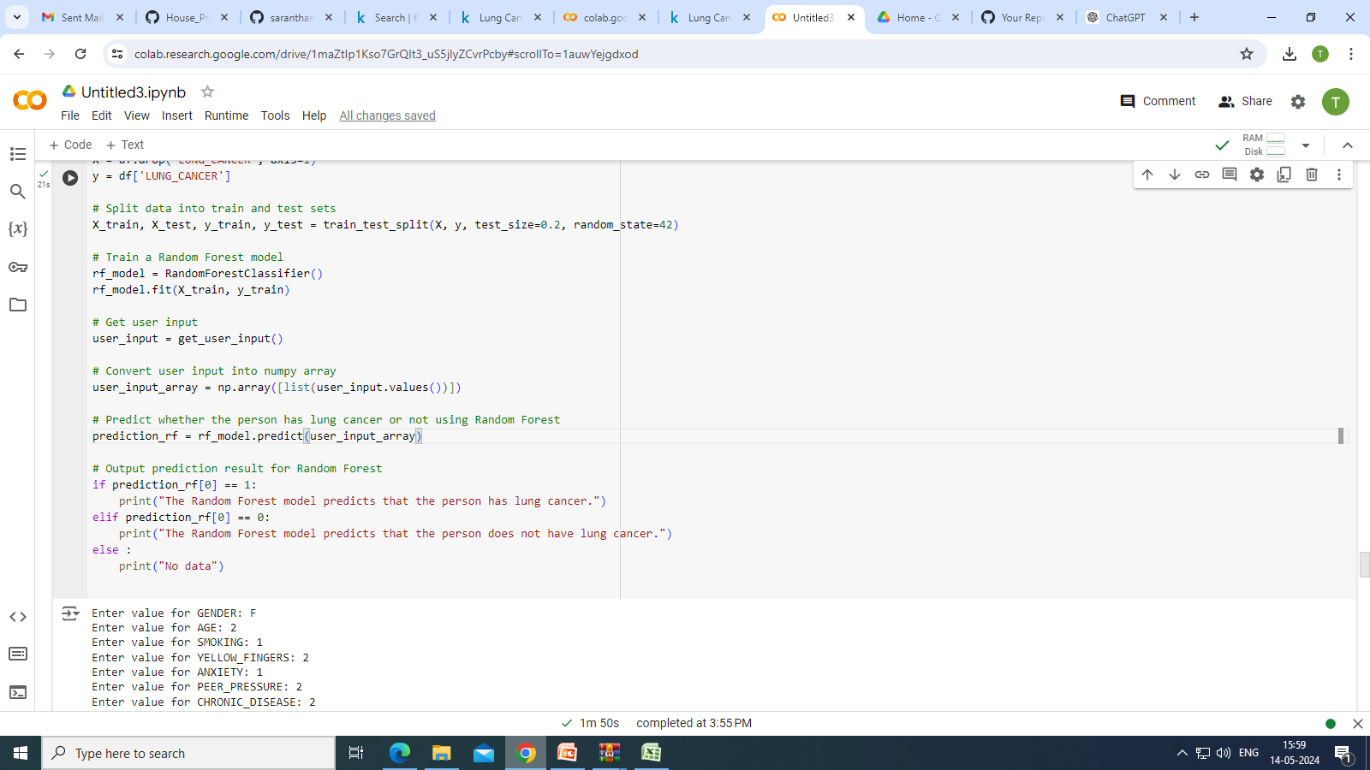

Slide 20
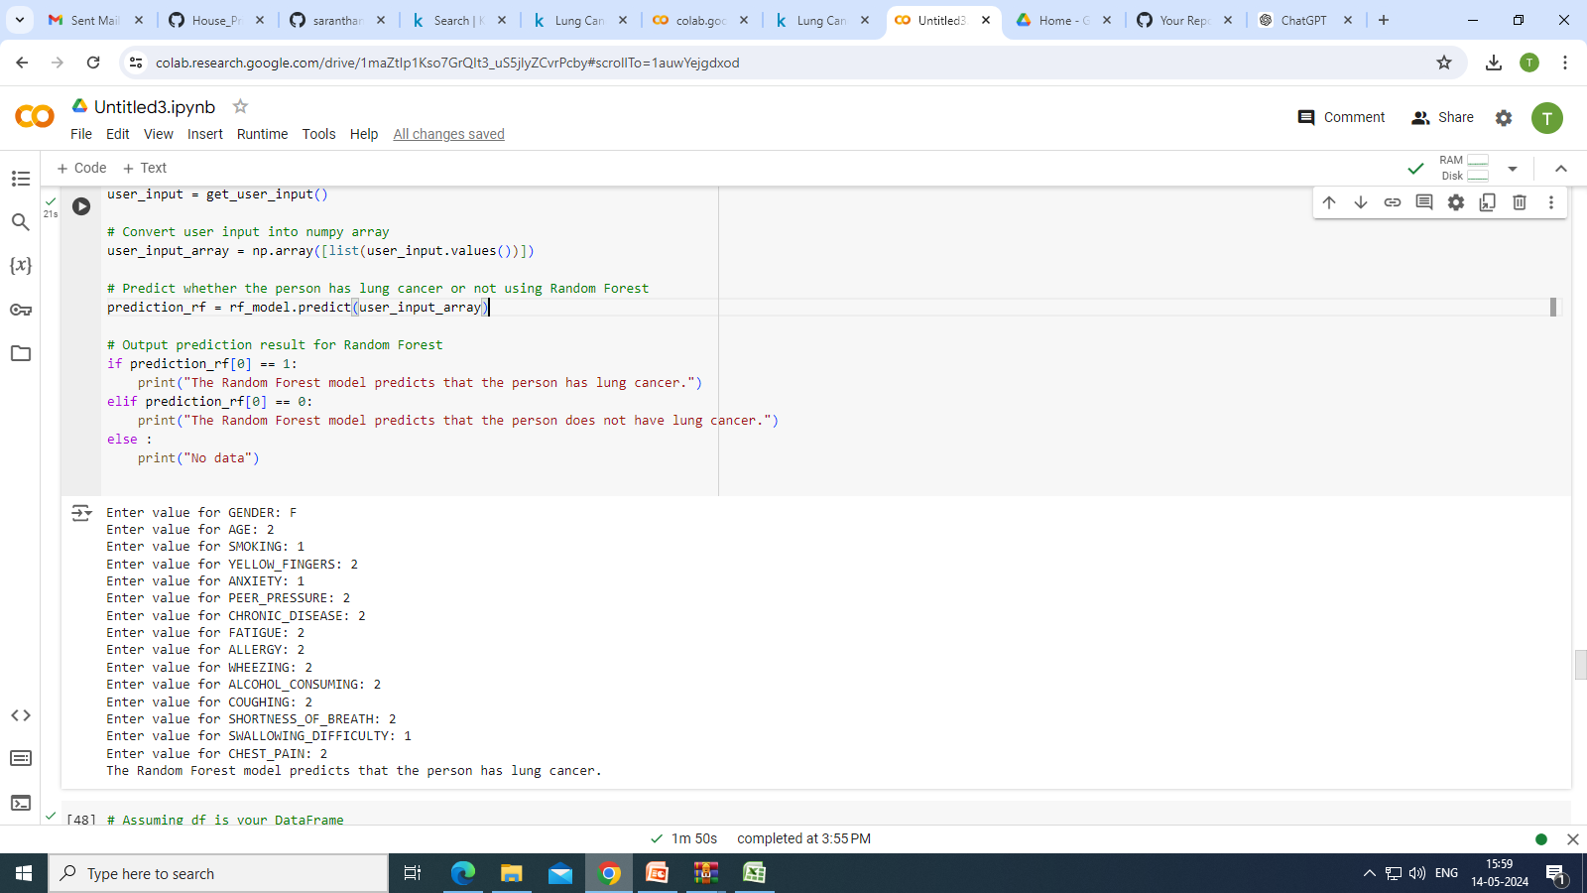

Slide 21
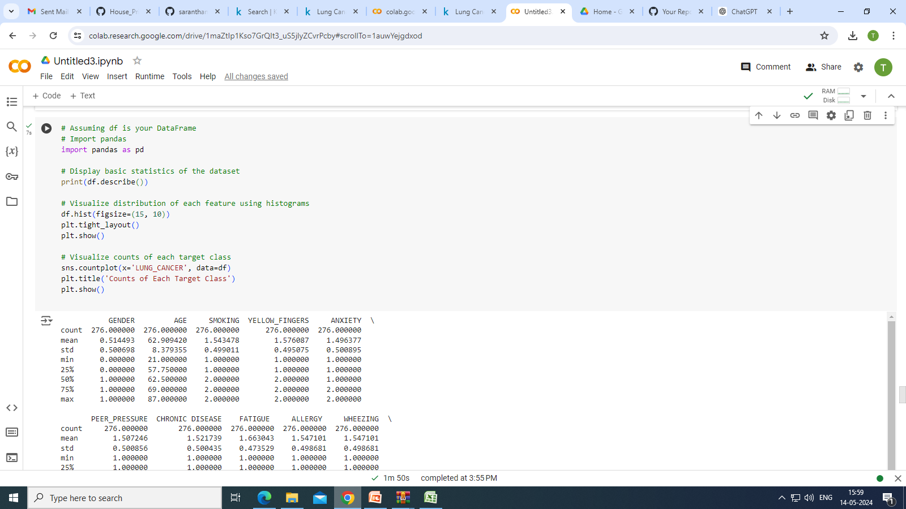

Slide 22
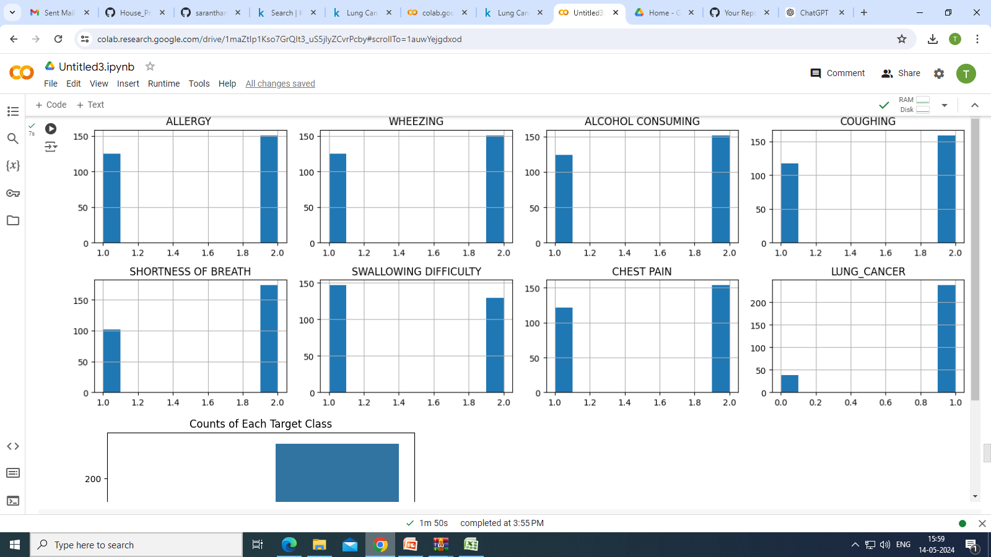
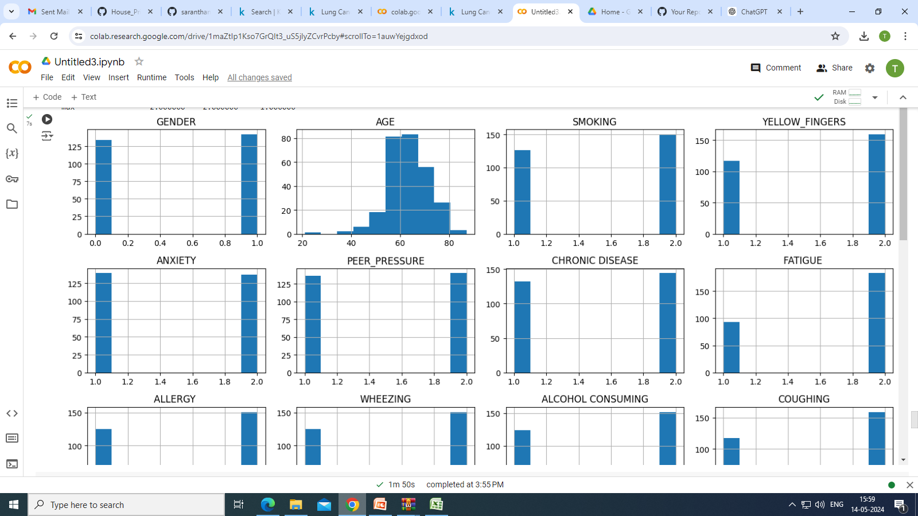

Slide 23
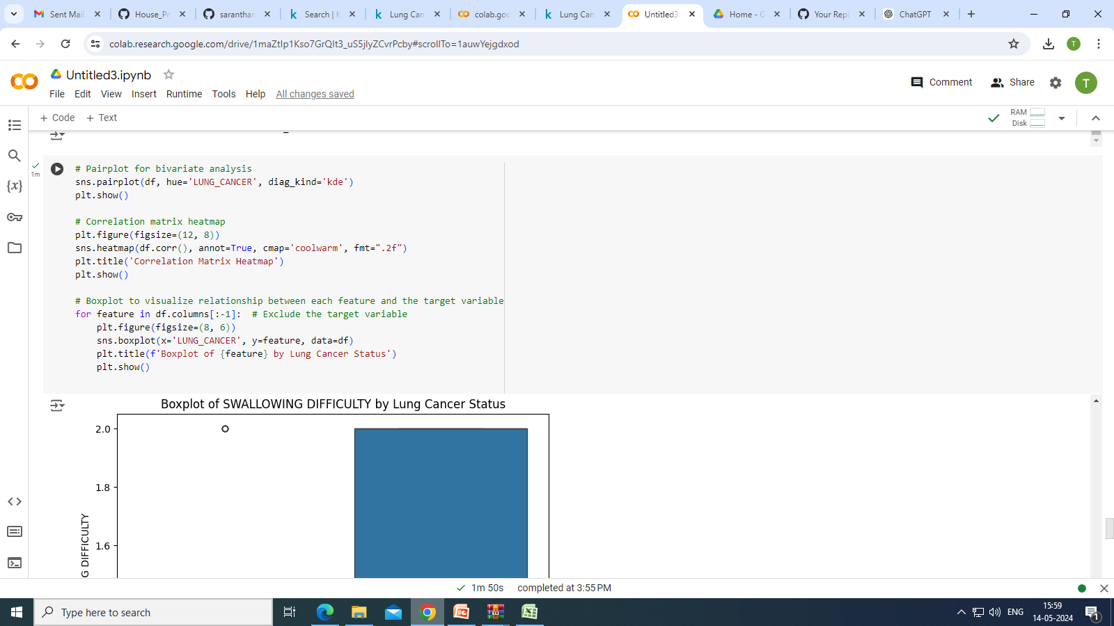

Slide 24
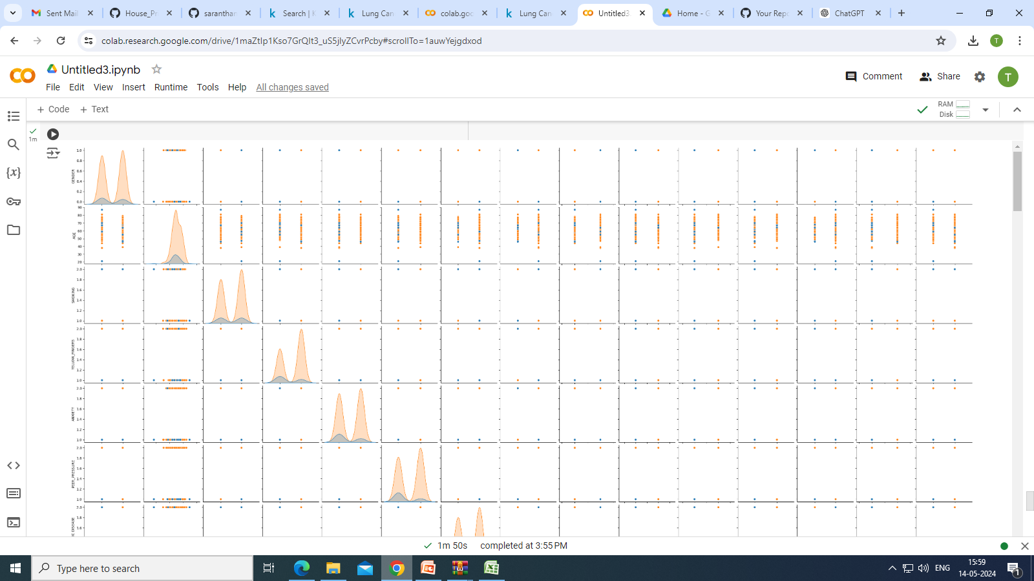

Slide 25
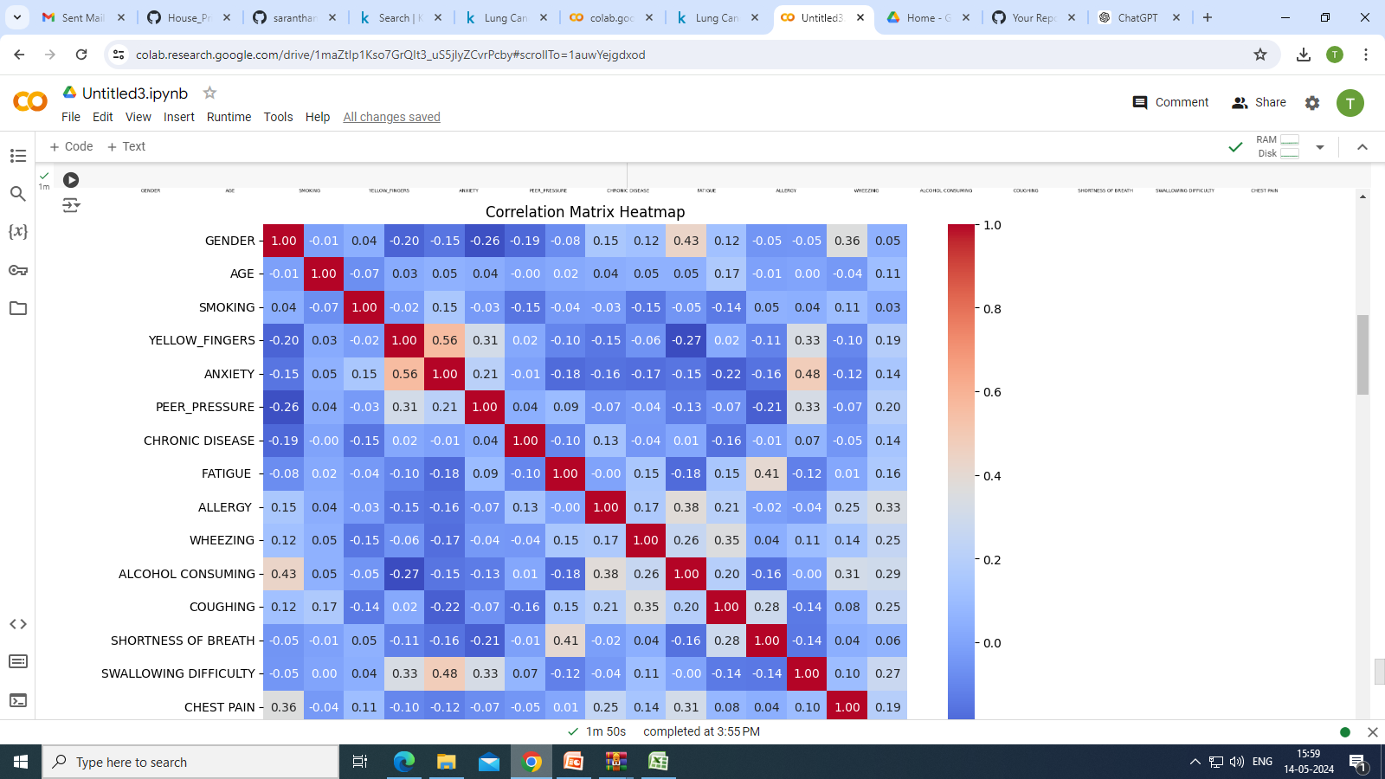

Slide 26
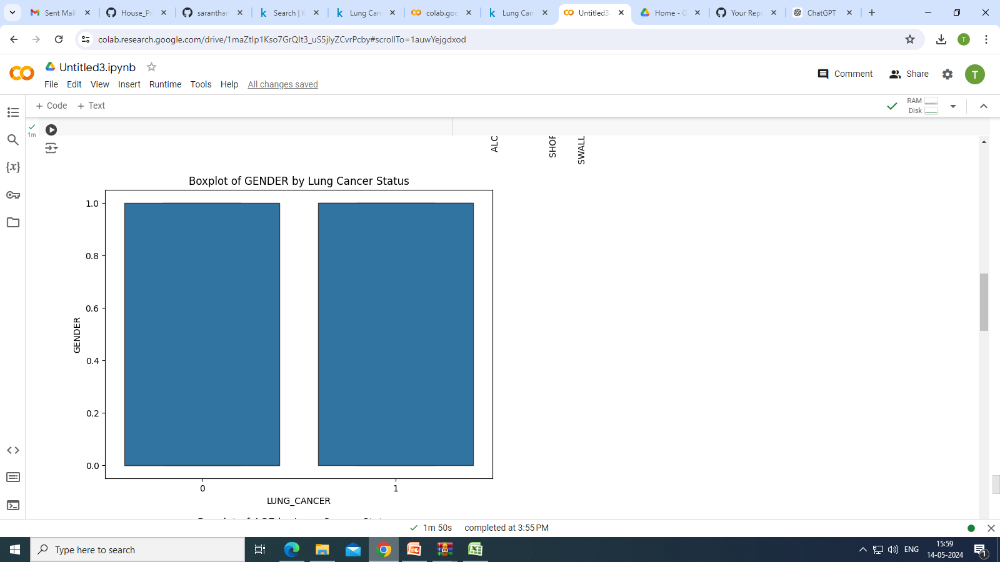

Slide 27
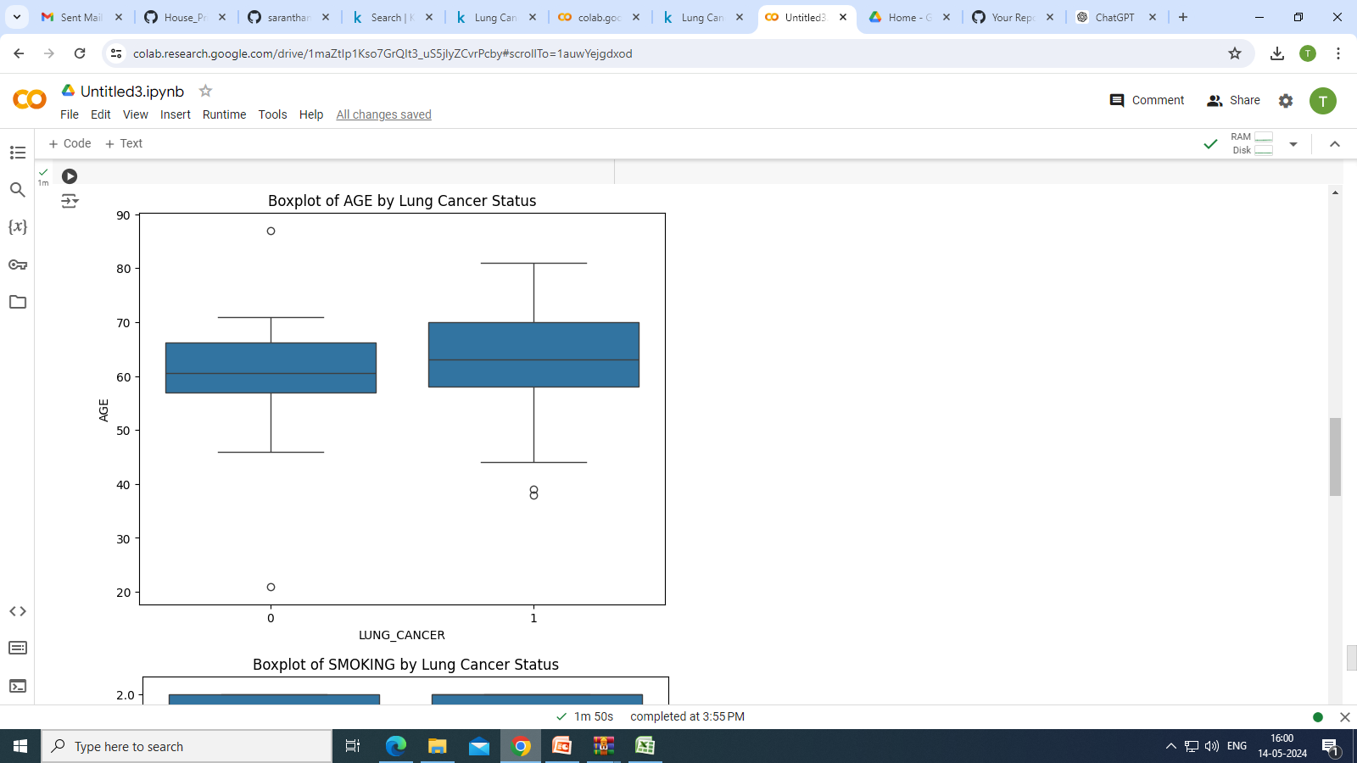

Slide 28
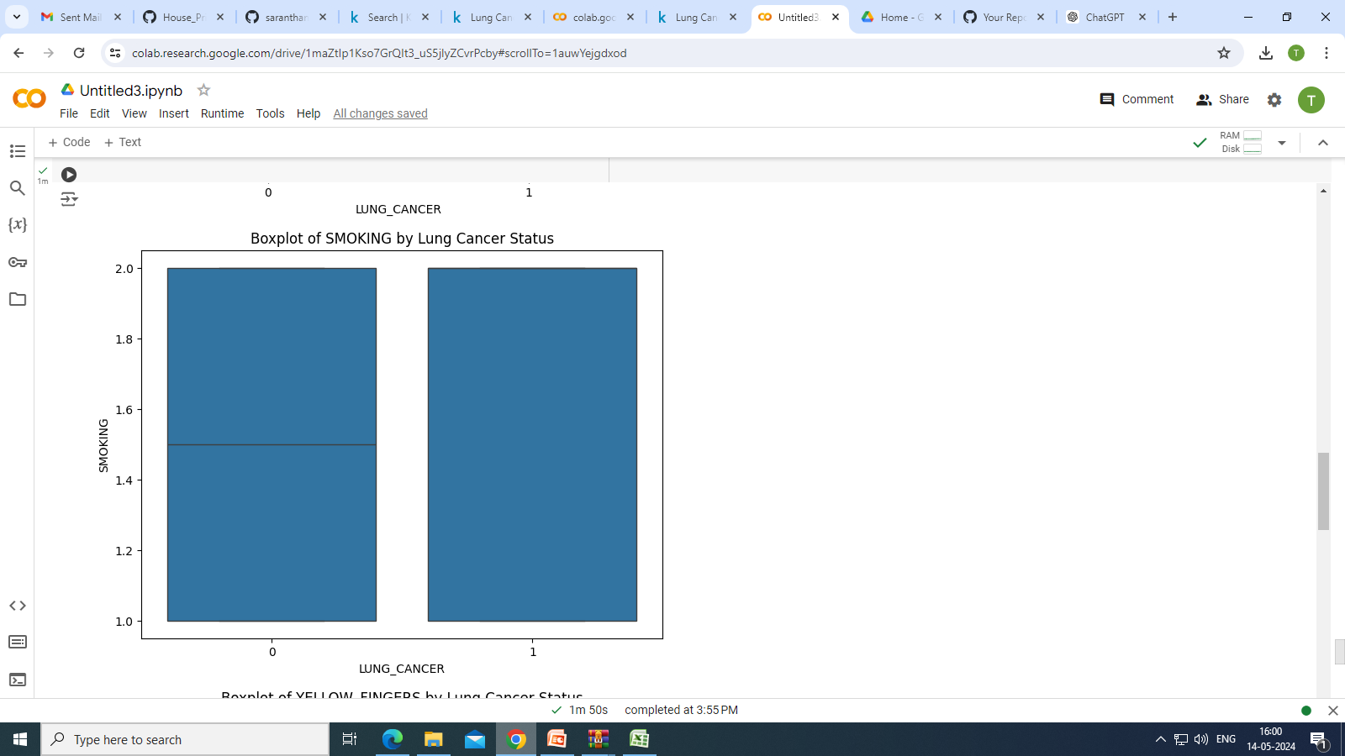

Slide 29
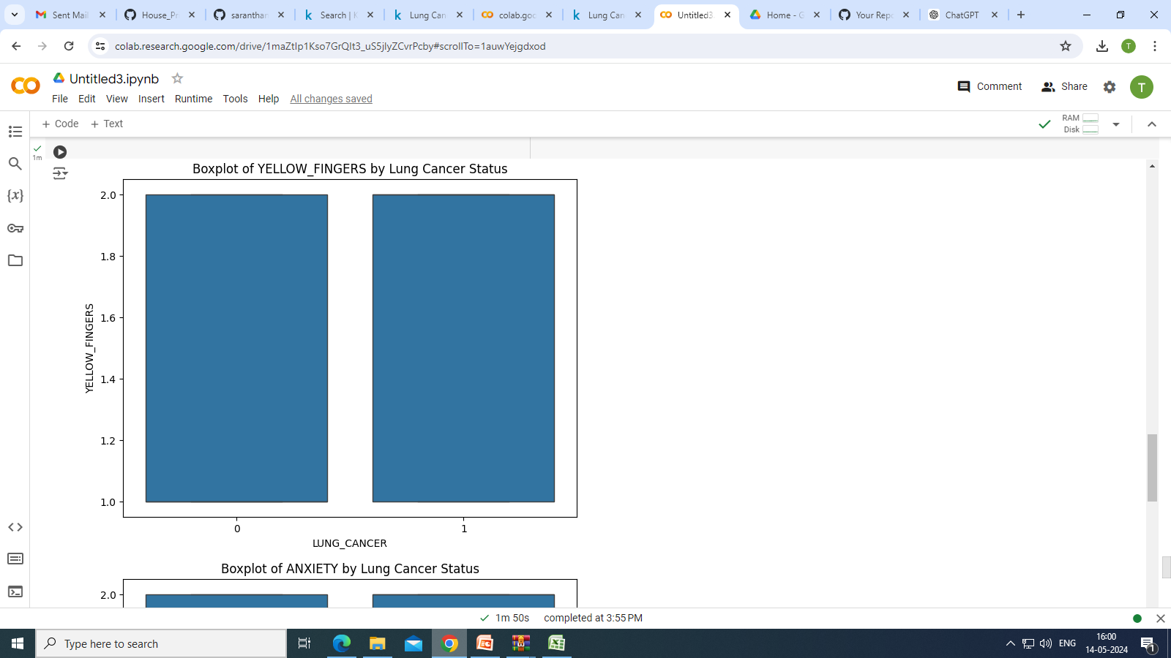

Slide 30
